Slide 1
PROJECT 2
CLASSIFICATION OF VOLE SKULLS
WITH GLM
Group 4
Sai Ram Vodnala
Carlos Quevedo Garza
Kevin Osei-Onomah
Soniya Shahi
November 2024

Slide 2






Introduction
Data Overview and Methodology
Table of Contents
Exploratory Data Analysis (EDA)
Model Development and Evaluation
Predictions

Slide 3
Introduction
Background
Objectives
Goals
Microtus subterraneus and M. multiplex are two vole species with distinct chromosomal counts and overlapping habitats in the Alps and northern Italy. Despite their similar morphology, no reliable cranial morphological criteria have been found to differentiate them effectively.
Develop and validate logistic regression models using cranial measurements to accurately classify the 199 unidentified voles into either subterraneus or multiplex voles.
To Build seven logistic regression models based on subsets of cranial features to accurately predict the species of 199 unidentified vole specimens.

Slide 4

Data Overview
The dataset consists of 288 skull measurements from two species, with 89 specimens classified through chromosomal analysis. The remaining 199 specimens are unclassified. Data Cleaning
3 sheets of data
First sheet (Unknown)
Skipped row between index 20 and 21
Hidden Row 8
Second sheet (Subterraneus)
Skipped row between index 13 and 15
Third sheet (Multiplex)
Skipped row
Duplicate data between index 30th and 31st row.
Note: Changed Column names and converted to CSV.

Slide 5
Methodology
Data Preparation
Exploratory Data Analysis (EDA)
Checked Missing values, data types and Created Boxplots to Identify Outliers.
Created Density charts to know distribution of a columns data.
Handled Outliers with Winsorization Technique.
Model Development and Training
Developed seven logistic regression models with seven feature combinations.
Use k-fold cross-validation during the training phase. (K=10)
Model Evaluation
Used key evaluation metrics Accuracy, Kappa and AIC.
Prediction
Predicting seven unknown data subsets with respective feature combination models.

Slide 6
Exploratory Data Analysis
Missing Values Removal
Removal of missing rows in each sheet
Removal of duplicates in multiplex sheet
Outlier Handling
Mitigation the impact of outliers by utilizing the percentile based approach.
Values above 97.5th percentile were deemed high outliers
Values below 2.5th percentile were deemed low outliers
Replaced high and low outliers with 97.5th and 2.5th percentile respectively for all sheets.

Slide 7
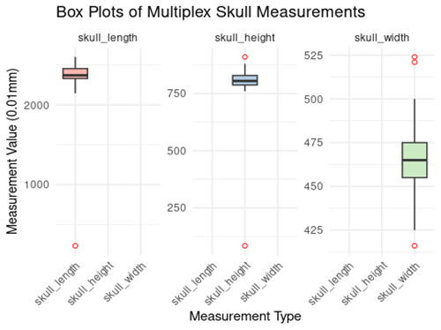
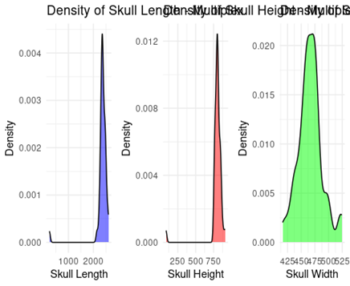
Multiplex Skulls
Before outlier handling

Slide 8
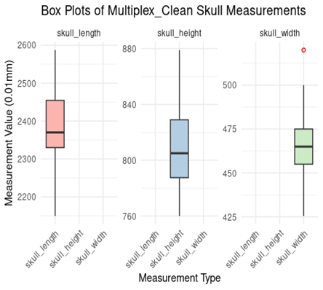
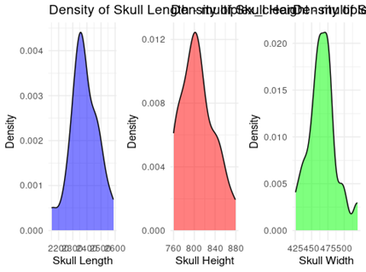
Multiplex Skulls
After outlier handling

Slide 9
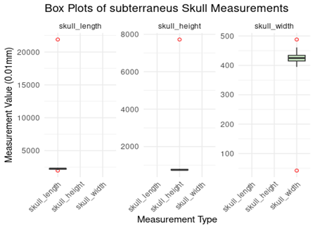
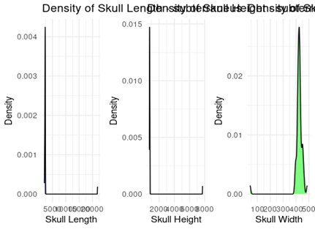
Subterraneus Skulls
Before Outlier handling

Slide 10
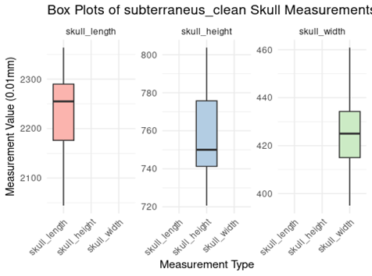
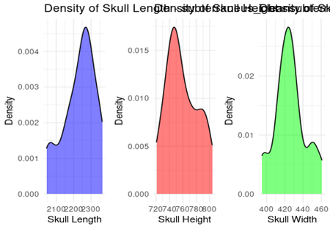
Subterraneus Skulls
After outlier handling

Slide 11
Model Development and Evaluation
Consolidated the labeled datasets for subterraneus and multiplex voles
Employed Ten-fold cross-validation
The final training and validation accuracies were obtained by taking the mean of the accuracies across the Ten iterations
Developed seven models, each representing a distinct combination of the three features (Length, Width, and Height)

Slide 12
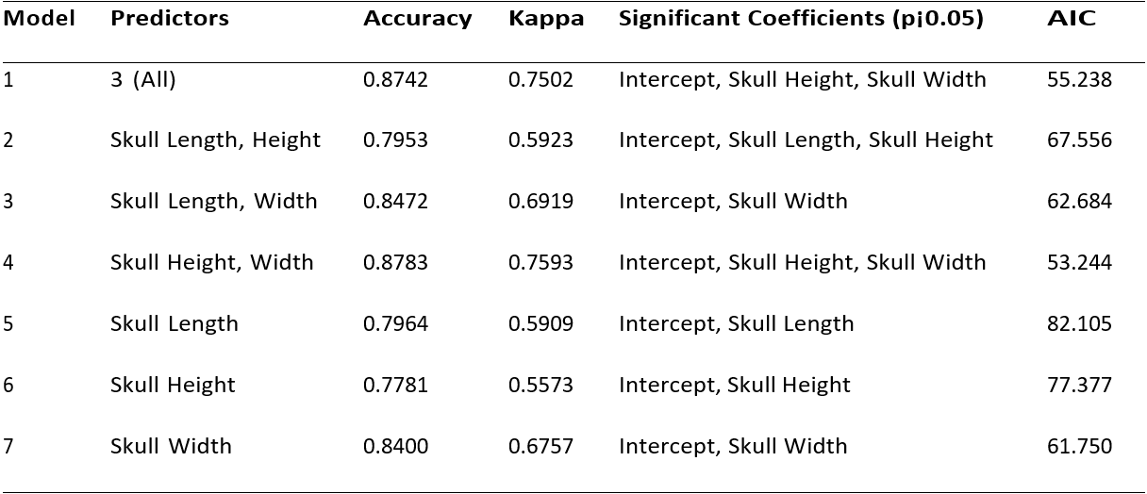
Model Development and Evaluation
Training Results

Slide 13
Predictions
Model | Features Used | Multiplex | Subterraneus
1 | Length, Height, Width | 67 | 50
2 | Length, Height | 11 | 7
3 | Length, Width | 10 | 10
4 | Height, Width | 10 | 8
5 | Length | 2 | 2
6 | Height | 6 | 3
7 | Width | 9 | 4
Total |  | 115 | 84

Slide 14
Conclusion
The comprehensive analysis revealed that the model Incorporating all three features (skull length, height, and width) and (Skull Height, Width) performed best, offering the highest classification accuracy and the lowest AIC, indicating a strong balance between model complexity and goodness of fit.

Slide 15
References
Airoldi, J.P., Flury, B.D., & Salvioni, M. (1995). Discrimination Between Two Species of Microtus.
Castro, H.M., & Ferreira, J.C. (2023). Linear and Logistic Regression Models.
DataCamp. (2022, December). Linear Regression in R Tutorial.
Johnson, D. (2023, September 30). GLM in R: Generalized Linear Model with Example
https://github.com/mominulislam2329/Logistic-Regression-STAT-601/blob/main/README.md
ChatGPT. (10/2024). Used for debugging and code cleaning. Retrieved from OpenAI

Slide 16
Thank You!!!.

